Slide 1
Predictive Power of the NFL Combine
Liam Rosengren and Parker Gibbons

Slide 2
TABLE OF CONTENTS
Motivation and Background
Correlation Test and MLR
01
03
Data Collection
Conclusions and Future Work
02
04
Why the combine? Why these positions?
What statistical analyses did we perform?
How did we get our data?
What were our results?

Slide 3
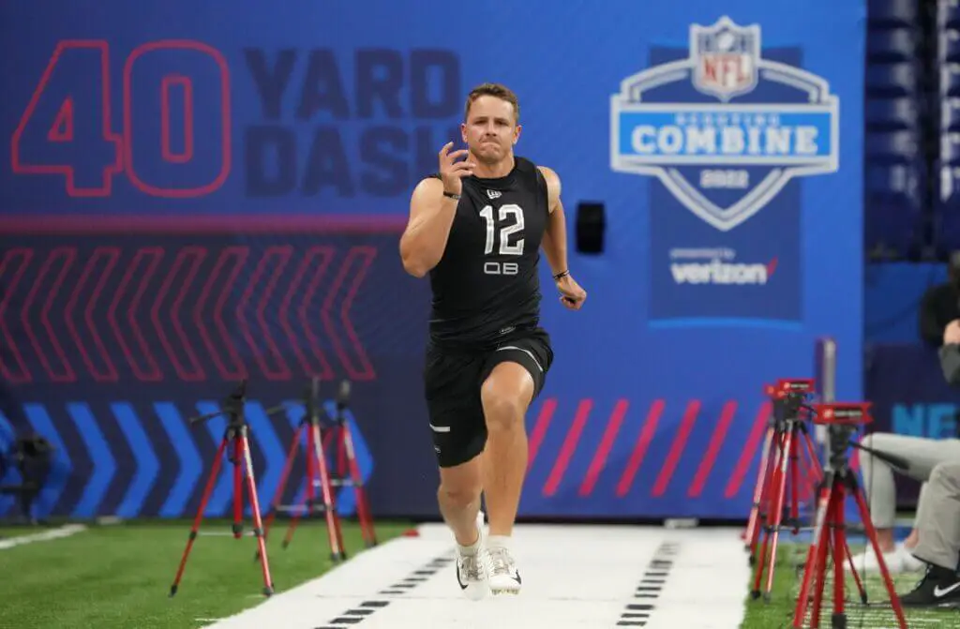
01
Motivation and Background

Slide 4
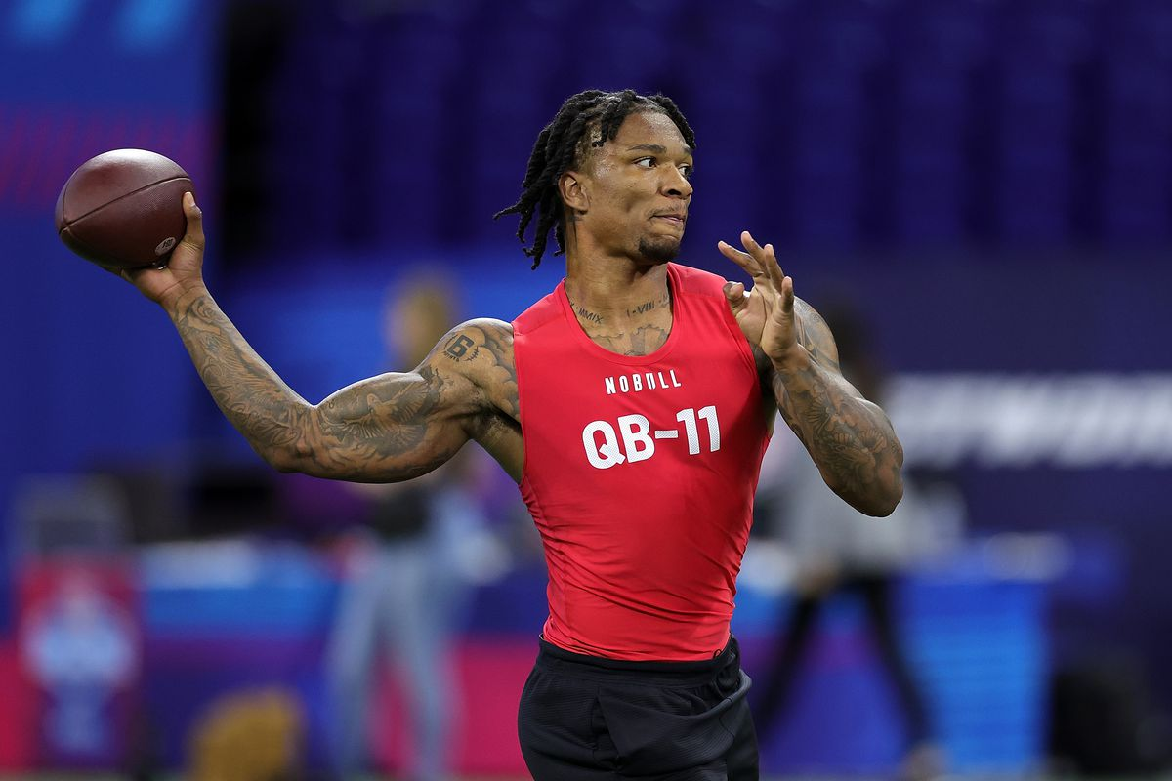
Motivation
NFL Combine results have been disputed for years
Current studies find little to no predictive power
From Yuva Chandana at The Sideline Catch, “Combine results lack any prediction power for neither draft order nor NFL performance. Raw athleticism may not be as important as people make it to be at the professional level.”
Has been used since 1982 with very little changes
Allows for consistent, unique data
Very popular among fans
Fantasy football observations
Inconsistent scouting makes fantasy football hard to predict
But…does the combine work?
Our Referenced Literature:
Does the NFL Combine matter?
Predictive Power of NFL Combine

Slide 5
02
Data Collection

Slide 6
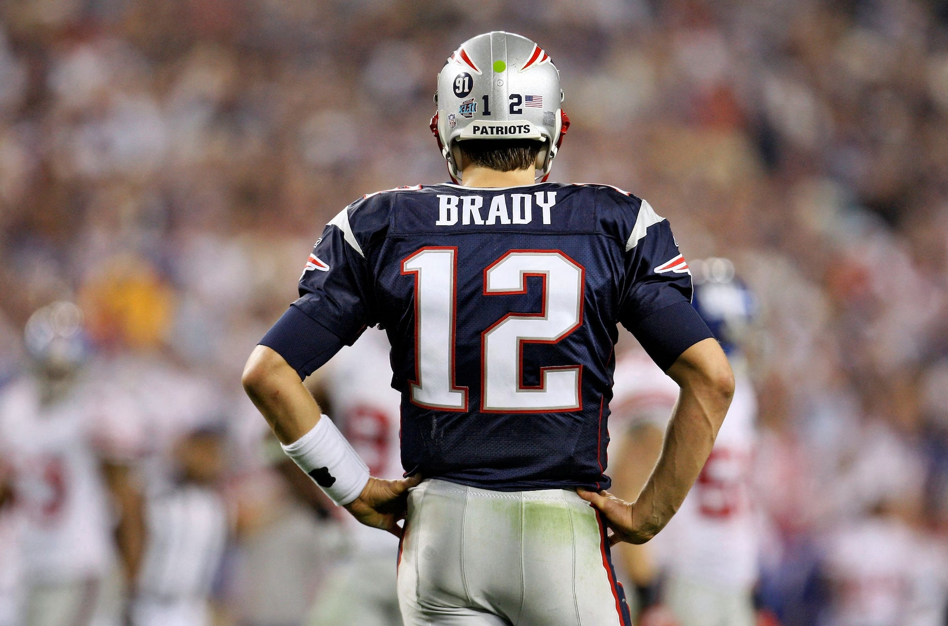
Data Wrangling
NFL Combine data from Kaggle (2014-2018) - Running backs and wide receivers
NFL Data on the following statistics from Pro Football Reference:
Height
Weight
Yards from Scrimmage (YScm) in first 3 NFL seasons
Yards from Scrimmage (YScm) for career
Merged combine data into one larger dataset
188 total observations with full combine data

Slide 7
03
EDA and MLR

Slide 8
Multiple Linear Regression Analysis - Average Yards
Exploratory Data Analysis
Significant correlations: Avg~Drafted (0.4549)
Started with full model (Adjusted R-squared: 0.2167 )
Significant variables (used T-value and P-value): Weight, drafted
40yd dash coefficient was very negative
Model selection process
Backwards elimination (step() function in STATs package)
Height, weight, drafted → Adjusted R-squared: 0.2312
Best subsets
Height, weight, drafted → Adjusted R-squared: 0.2312, CP (estimates size of the bias) = 0.587
Chosen model: (average yards ~ height + weight + drafted)

Slide 9
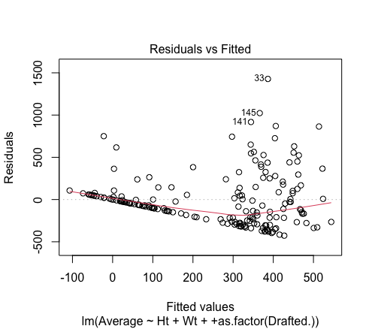
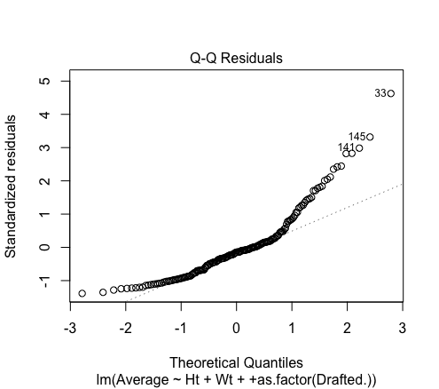
Model Conditions
Resids versus fits - Problems with zero mean and constant variance (uneven scatter)
QQ plot - Deviation from normality (from normal curve)
No concerning VIFs - Lack of multicollinearity
Variable | VIF
Ht | 1.4062
Wt | 1.4081
Drafted | 1.0132

Slide 10
Multiple Linear Regression Analysis - Total Career Yards
Started with full model (Adjusted R-squared: 0.1784 )
Significant variables (used T-value and P-value): Weight, drafted
Height and 40yd dash coefficients were negative, 40yd very negative
Model selection process
Backwards elimination (step() function in STATs package)
Height, weight, 40yd, vertical jump, drafted → Adjusted R-squared: 0.1963
Best subsets
Height, weight, vertical jump, drafted → Adjusted R-squared: 0.196, CP = 1.12
Chosen model: (total yards ~ height + weight + vertical jump + drafted)

Slide 11
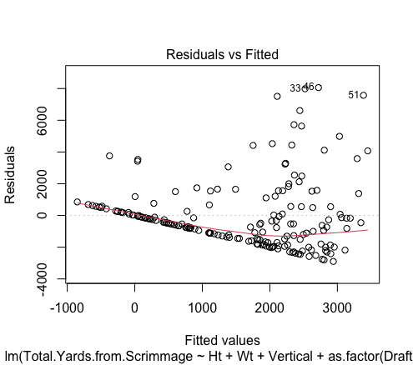
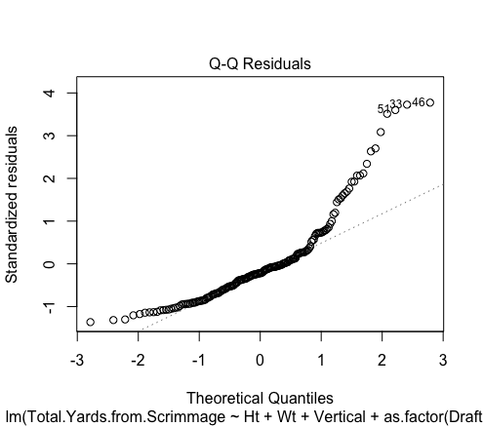
Model Conditions
Resids versus fits - Problems with zero mean and constant variance (uneven scatter)
QQ plot - Deviation from normality (from normal curve)
No concerning VIFs - Lack of multicollinearity
Conditions violated similarly (if not slightly worse) than the average yards model
Variable | VIF
Ht | 1.3940
Wt | 1.3986
Vertical | 1.1511
Drafted | 1.1629

Slide 12
Regression Conclusions
Conditions not met well for either model - Model may not provide accurate insights
Zero mean, constant variance, normality
No combine metrics were significant at the 10% level (only height, weight, and drafted
VIFs show no concerns with multicollinearity
No large difference between the two models - Need more metrics (maybe college statistics)
Could first three years be predictive of a whole career?
Confirms previous findings on lack of predictability of combine data on NFL performance
Possibility of Omitted Variable Bias (not including college data, team performance data)

Slide 13
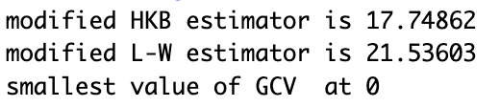
Ridge Regression
04
A solution to overfitting and mitigating OVB

Slide 14
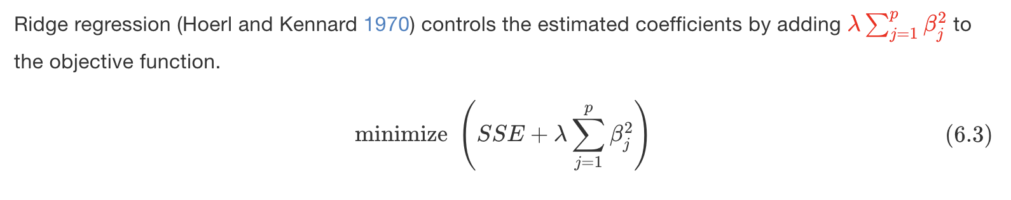
Why Ridge Regression?
High Hoerl-Kennard-Baldwin (HKB) and Lawless-Wang (L-W) estimators
HKB was ~17, LW was ~21
Suggests a significant need for regularization
Indicate high levels of multicollinearity
Data is likely suffering from overfitting

Slide 15
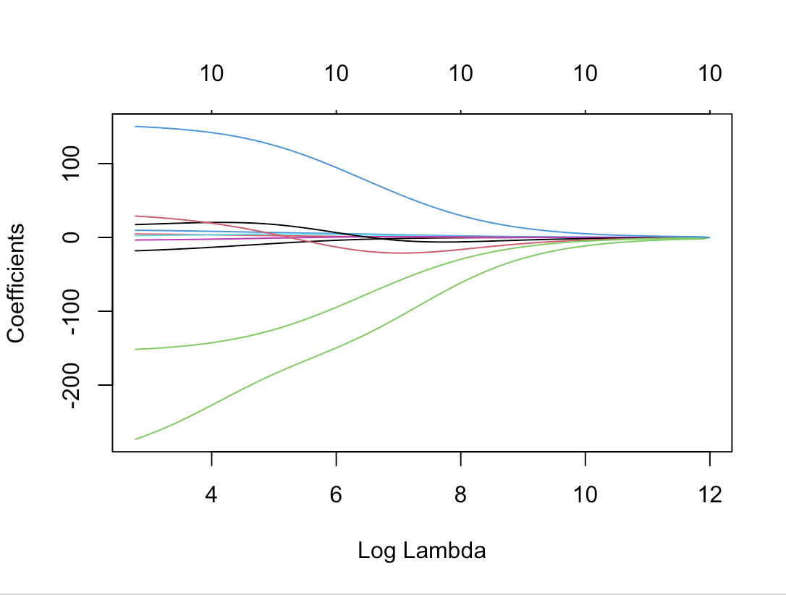
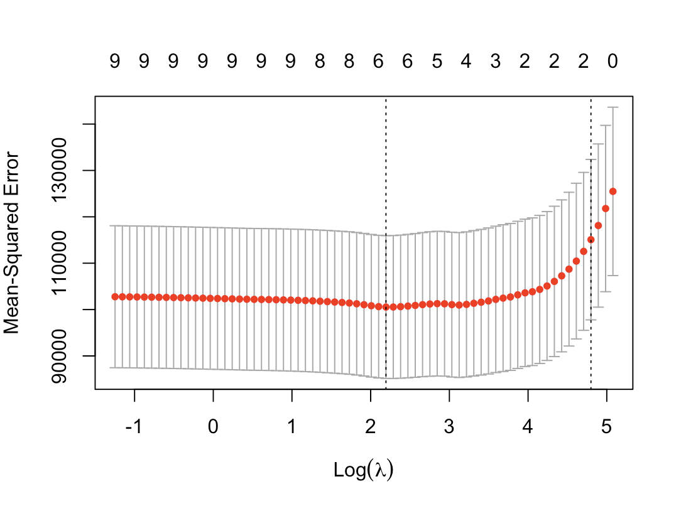
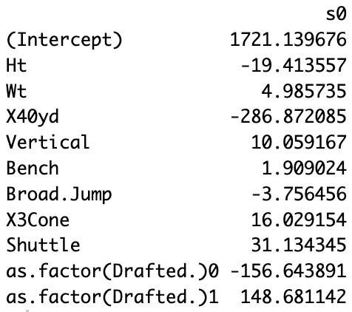
PETER HILL
Ridge Regression using glmnet( ) as illustrated in Chapter 6 of the textbook
cv.glmnet( ), which automatically performs k-fold cross validation to assist with generalizability and get our optimal λ of 8.97
Use that to find our coefficients
R2 = 0.254

Slide 16
Conclusions and Future Work
05

Slide 17
Conclusions
Combine data is a poor predictor of NFL success
No significant relationships between any combine drill and average YScm
Ridge regression improved R2 slightly
Not enough to say that our model is complete
Clearly still high chance of OVB
Ridge regression appears to have been appropriate
Reduced our degree of overfitting
HKB and LW decreased by 8-10 each
Still a possibility of OVB
Our hypothesis of a lack of predictive power is confirmed

Slide 18
Potential Future Applications/Ideas
Use a larger data set to confirm results
Use more years of combine data (many combine participants do not have long careers)
Apply prediction test to individual teams
Are certain teams better than others at drafting/scouting?
49ers don’t use as much combine data
Rams have had recent 5th round success
What do the teams better at drafting/scouting have in common?
Use college in-game performance data
Likely best predictor of NFL success
Also one of the most used scouting tools by NFL teams
Could use it to predict initial success and career success
Apply more ML/Statistical methods
Principal Component Analysis (PCA) - Popular dimensionality reduction technique
Apply Nonparametric analyses

Slide 19
References
https://thesidelinecatch.com/2023/03/05/does-the-nfl-combine-matter/#:~:text=The%20study%20stated%20that%2C%20%E2%80%9Cit,be%20at%20the%20professional%20level.%E2%80%9D
https://journals.lww.com/nsca-jscr/Fulltext/2016/05000/Predictive_Value_of_National_Football_League.25.aspx
https://www.silverandblackpride.com/2023/3/4/23625519/raiders-nfl-combine-quarterbacks-anthony-richardson-cj-stroud-will-levis
https://bradleyboehmke.github.io/HOML/regularized-regression.html

